Slide 1

UNIVERSITI TEKNOLOGI MALAYSIA
Cricket Data Scraping and Analysis for Robust Data-Driven Decisions
Candidate: Laiba Nadeem
Matric No: MCS241005

Slide 2
Presentation Content
Cricket Data Scraping and Analysis for Robust Data-Driven Decisions
Introduction
Research Methodology
1
3
2
4
Literature Review
Initial Findings

Slide 3
INTRODUCTION

Slide 4
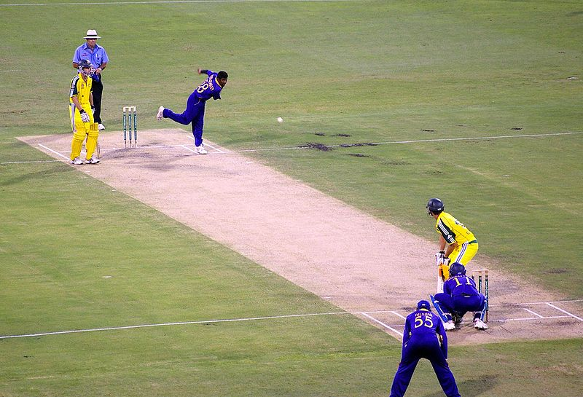
Cricket Background
Cricket is a bat-and-ball game played between two teams of 11 players. The game is played on a field with a 22-yard pitch in the center, with wickets at both ends. The bowler throws the ball toward the striker, who tries to hit it and score runs by switching places with the non-striker. Runs can also be scored if the ball reaches the boundary or if the bowler makes an illegal delivery.

Slide 5
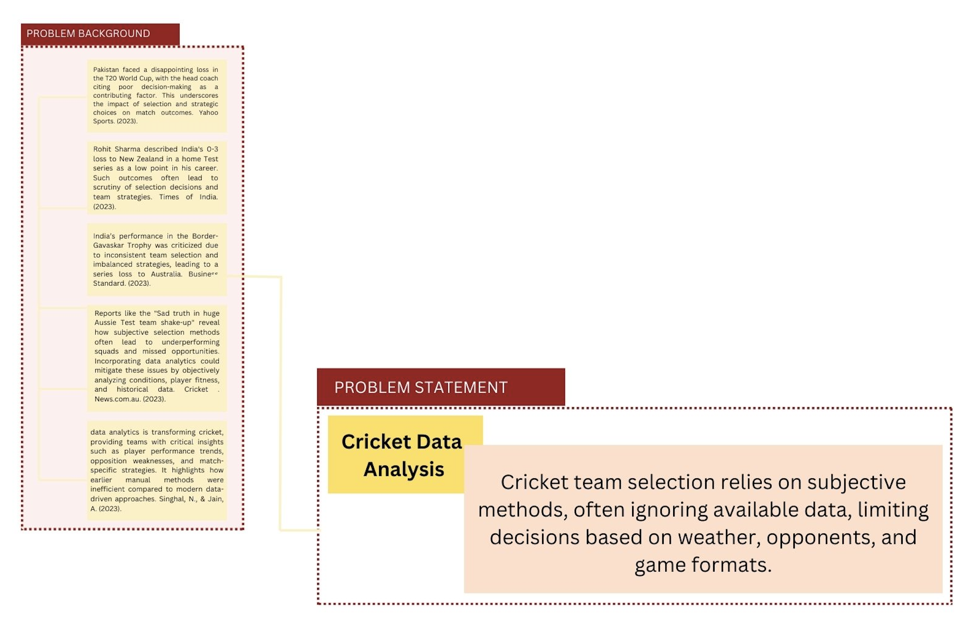
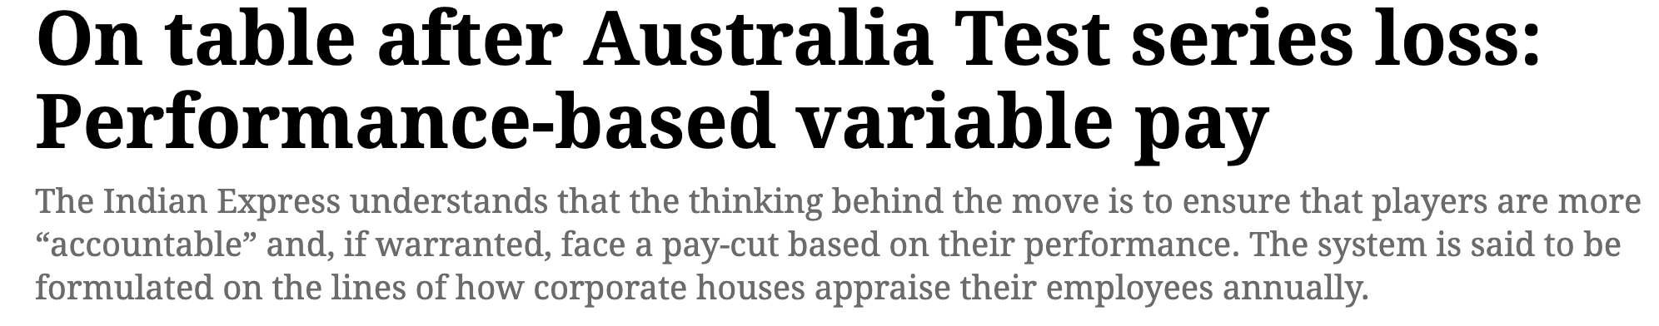
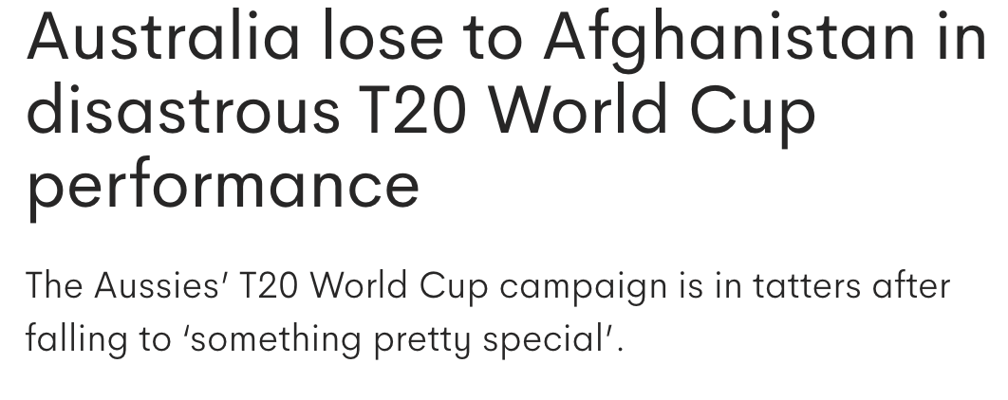
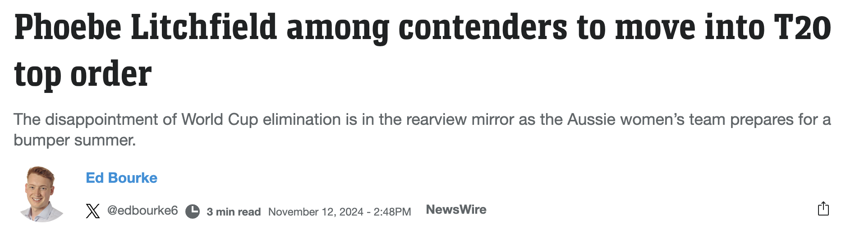
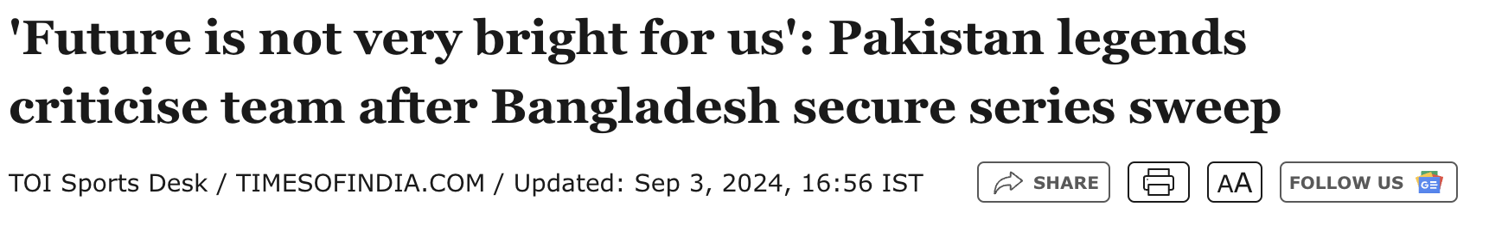
Introduction
Problem Statement and Background

Slide 6
LITERATURE REVIEW

Slide 7
RESEARCH QUESTIONS AND OBJECTIVES
RESEARCH QUESTIONS | RESEARCH OBJECTIVES
How can cricket data be collected, processed, and used to effectively to get data-driven solutions? | To collect and preprocess the cricket data from various sources that include insights and players statistics.
What key metrics are the most important in getting useful insights for team formation? | To analyze different metrics of the players like their strike rates, batting average, wicket-taking ability, and bowling economy to check their suitability for different matches.
How can visualization tools improve the interpretability of the data insights for the team management and coaches? | To provide insights based on the match like batting order or bowling line or the placement of players in the field.
To what extent can Data-driven decisions improve the performance of the team as compared to the traditional method? | To provide visualization of the important insights gathered from the data using visualization tools, like Power BI.

Slide 8
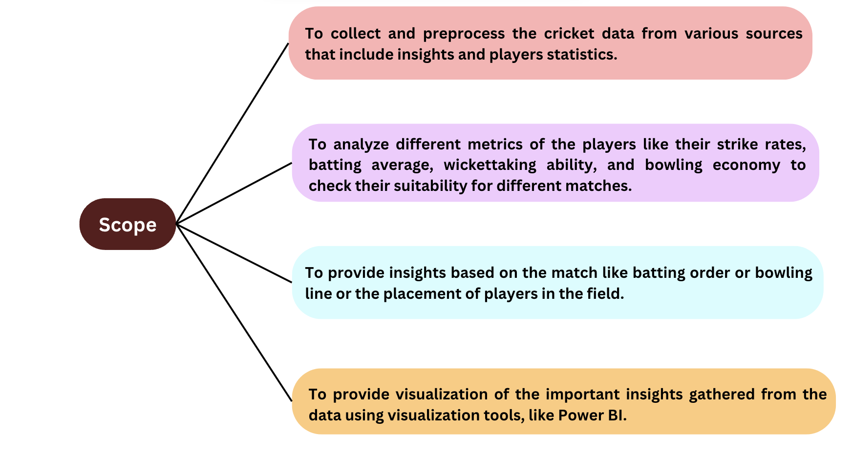
Introduction
RESEARCH SCOPE

Slide 9
RESEARCH GAP
Paper | Key Findings | Gaps/Limitation
Kumar et al., 2019 | Machine learning models for player performance prediction in cricket. | Limited ability to predict player performance under real-time match conditions.
Sengar et al., 2020 | Hierarchical models for player performance prediction in cricket. | Incomplete or inconsistent real-time data collection during matches.
Batra et al., 2020 | Use of IoT sensors to measure shot quality and player performance. | Challenges with data normalization and sensor integration.
Singh et al., 2021 | Bayesian models for predicting player performance and team selection. | Difficulty adjusting for real-time conditions like weather, injuries, or fatigue.
Verma et al., 2021 | Use of predictive modeling based on match data, player rankings, and handedness. | Incomplete data affecting model accuracy.
Gupta et al., 2022 | Machine learning for cricket team performance benchmarking. | Need for more sophisticated metrics beyond traditional statistics.
Patel et al., 2022 | Clustering methods for team selection based on complementary abilities. | Lack of dynamic integration of match data and player injuries.

Slide 10
RESEARCH METHODOLOGY

Slide 11
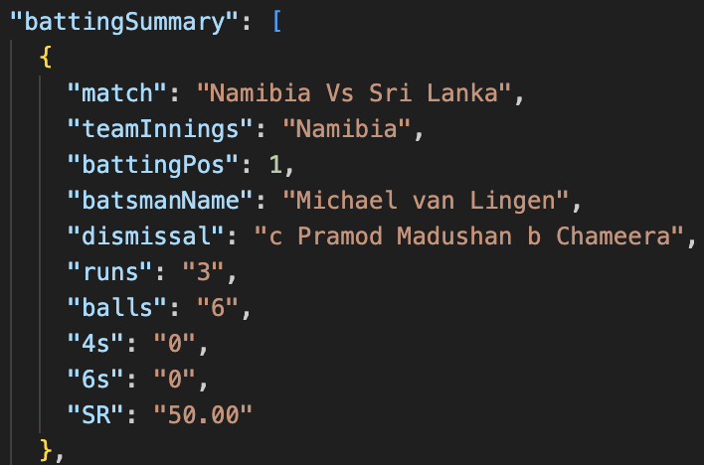
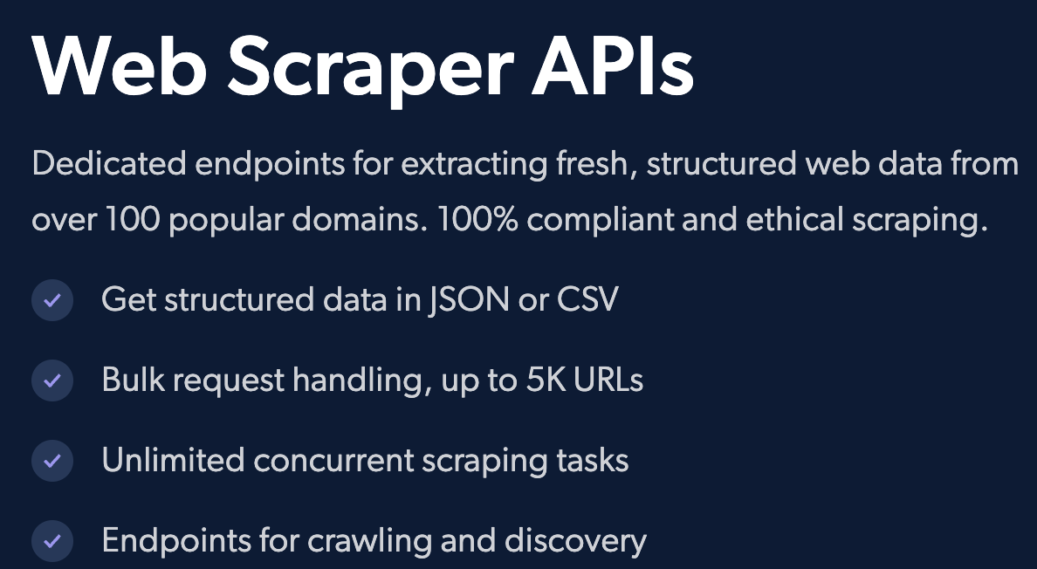
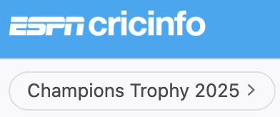
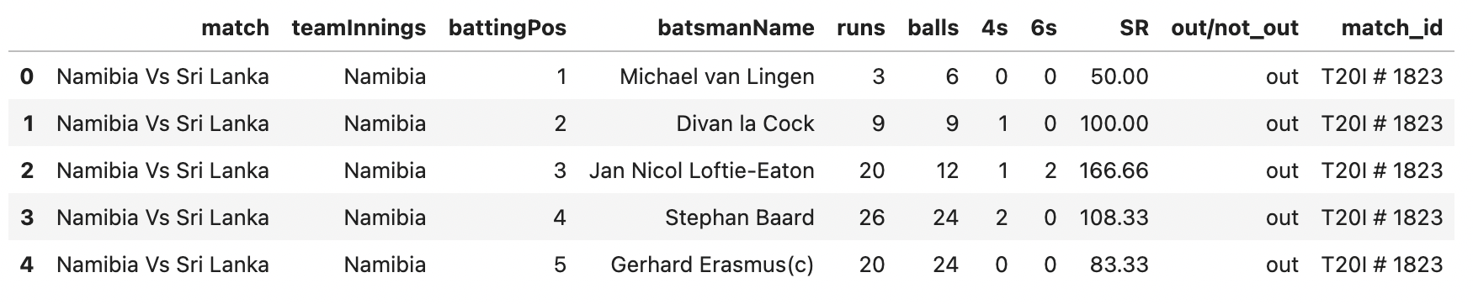
Data Preprocessing
Data Collection
Data Transformation
Data Cleaning
Collected data using Bright data web scrapper from ESPN Cricinfo website.
Data collected from ESPN Cricinfo was in JSON format and was converted into CSV
Next step was data cleaning, looking for null values and handling them.

Slide 12
INITIAL FINIDINGS

Slide 13
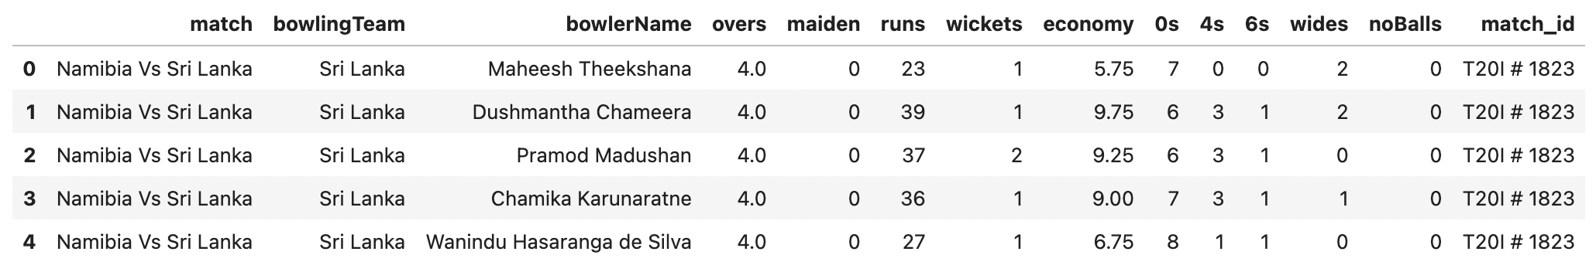
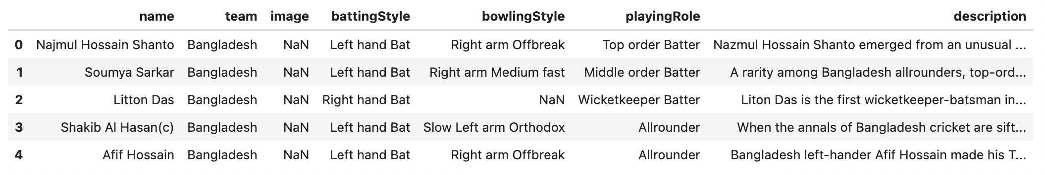
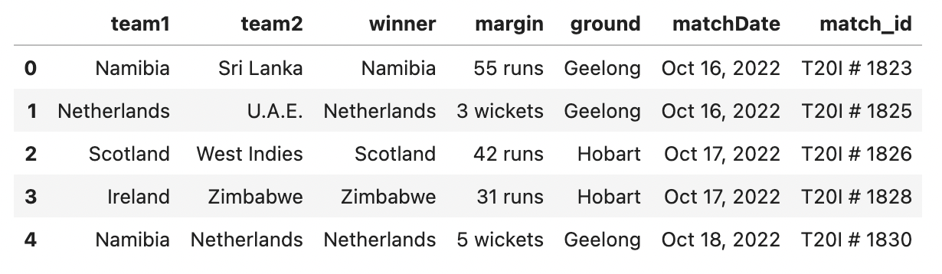
DATASETS
Bowling Data
Batting Data
Players Data
Match Data

Slide 14
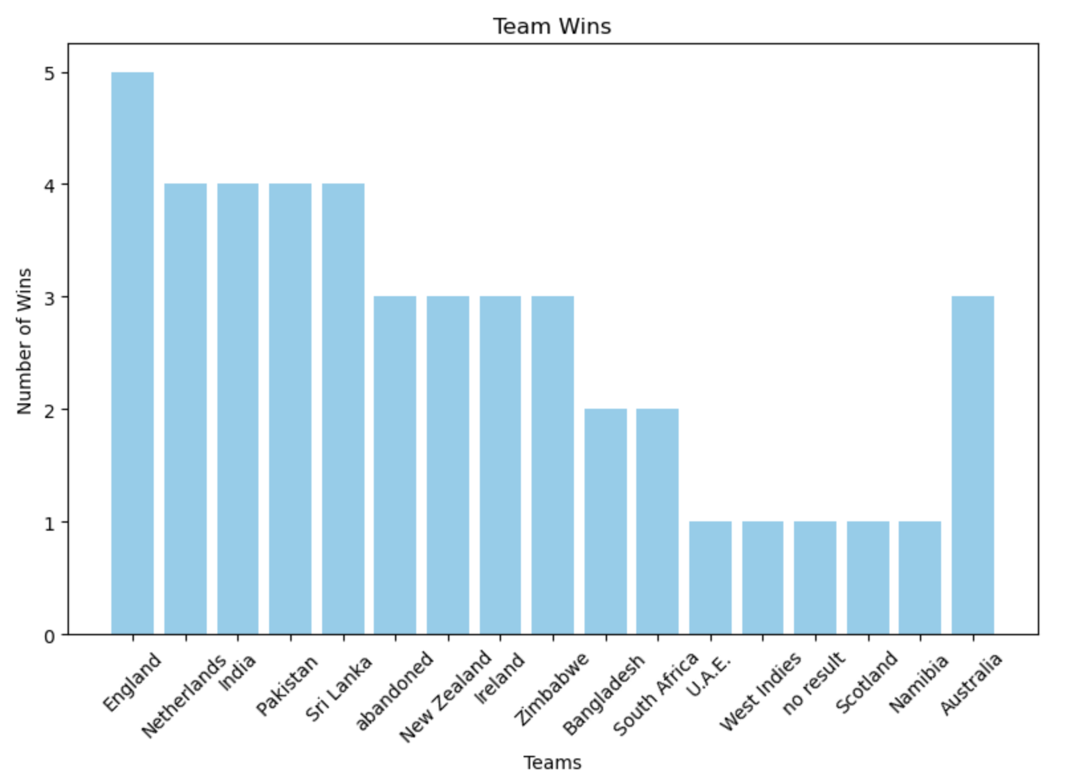
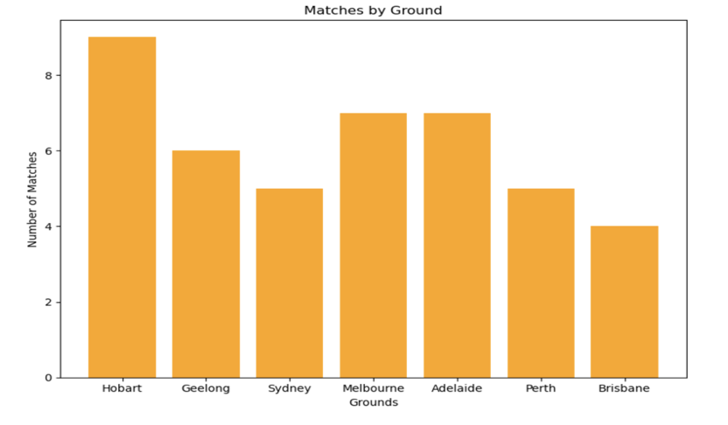
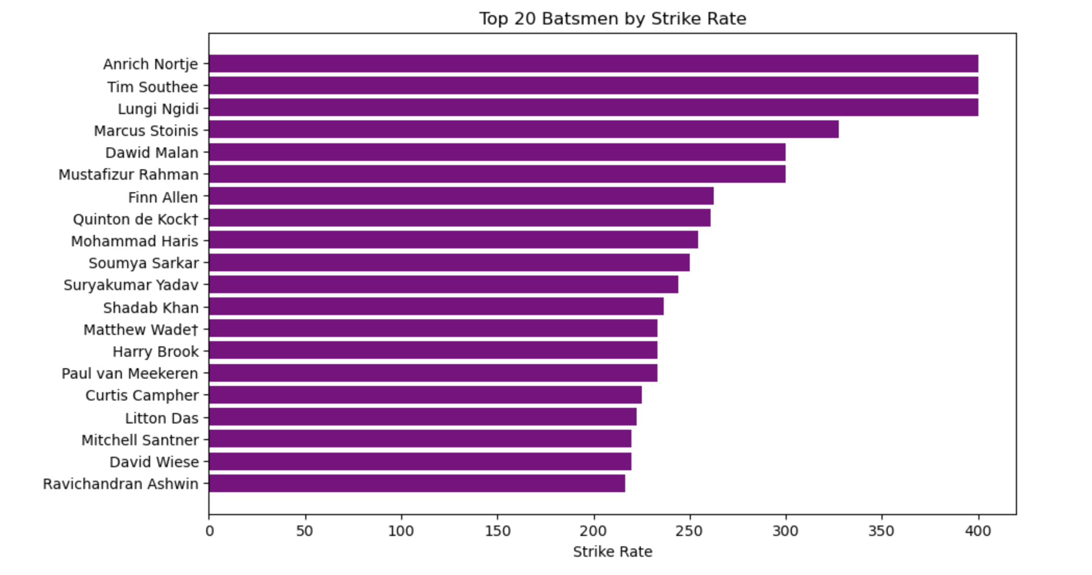
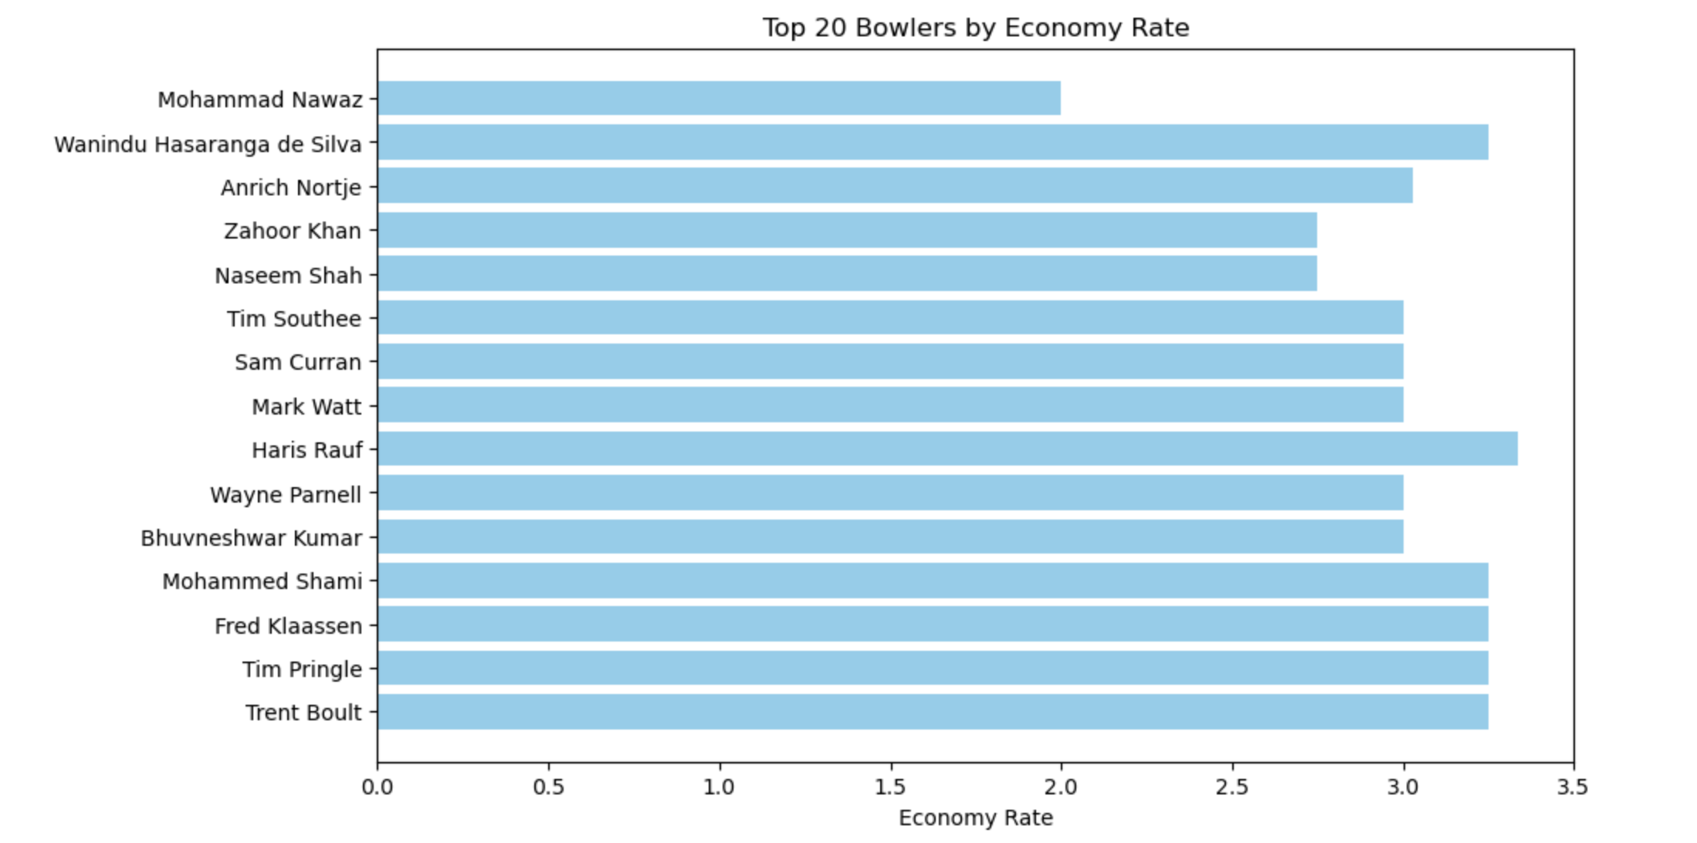
Insights from Data Analysis
Top team with most wins was England
Most T20’s
Were played in
Hobart
ANALYSES
Ordered the batsmen
Based on Their
Calculated strike rate
Ordered the
Bowlers
Based on
Their
Calculated
Economy rate

Slide 15
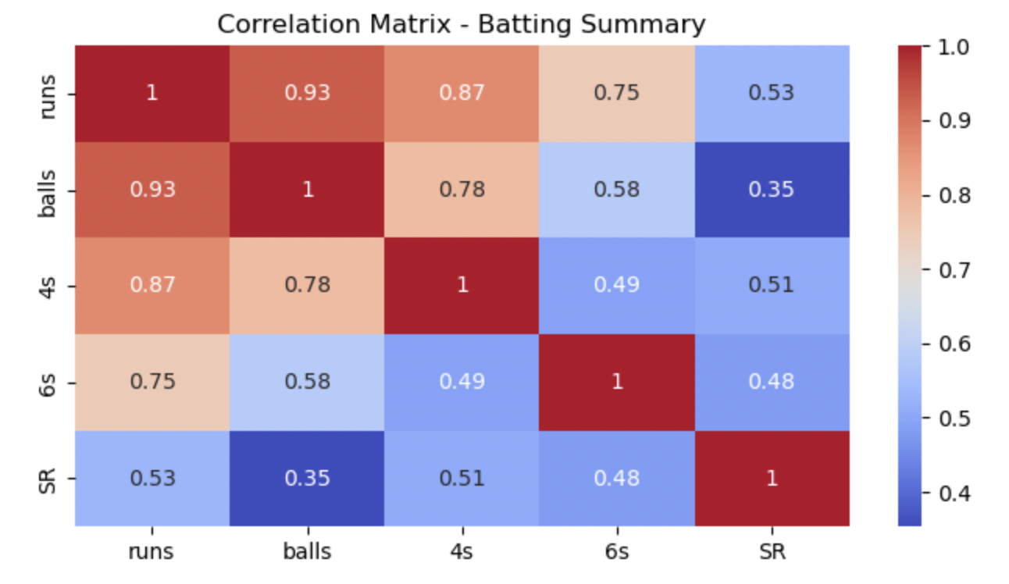
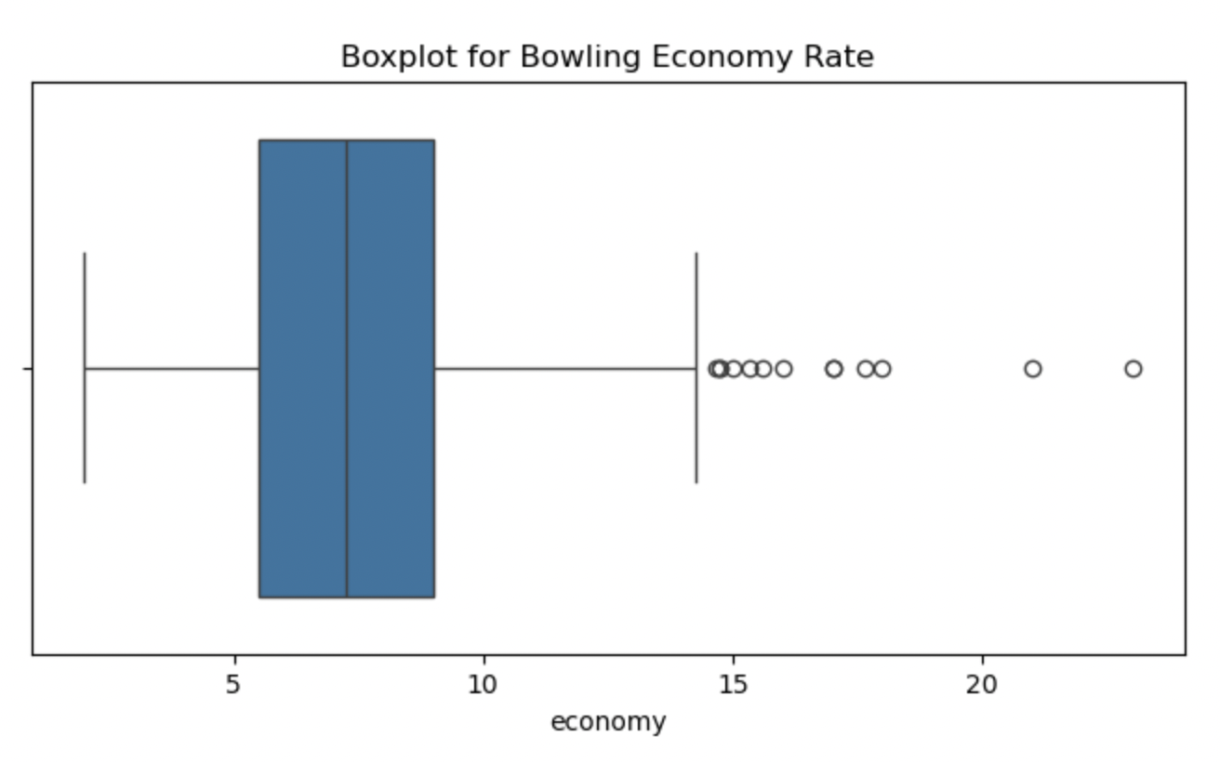
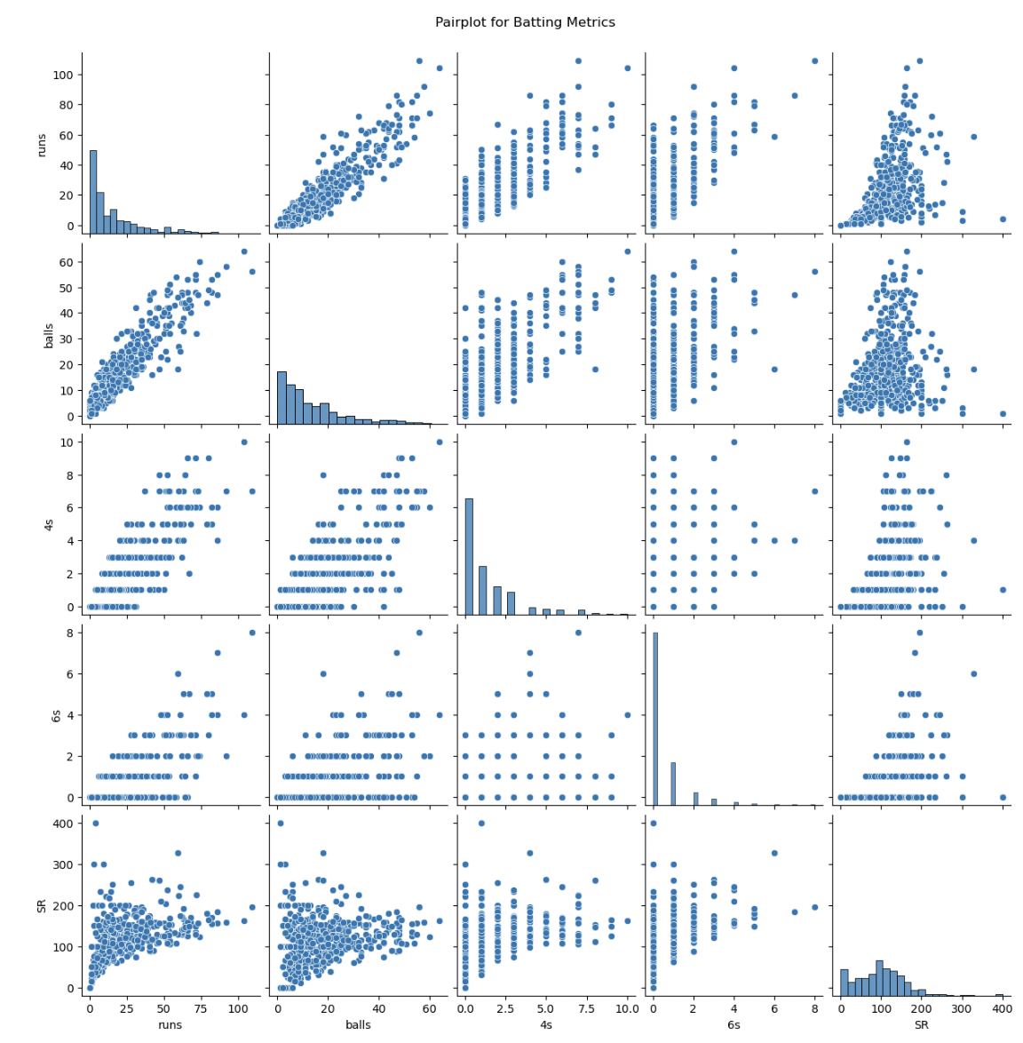
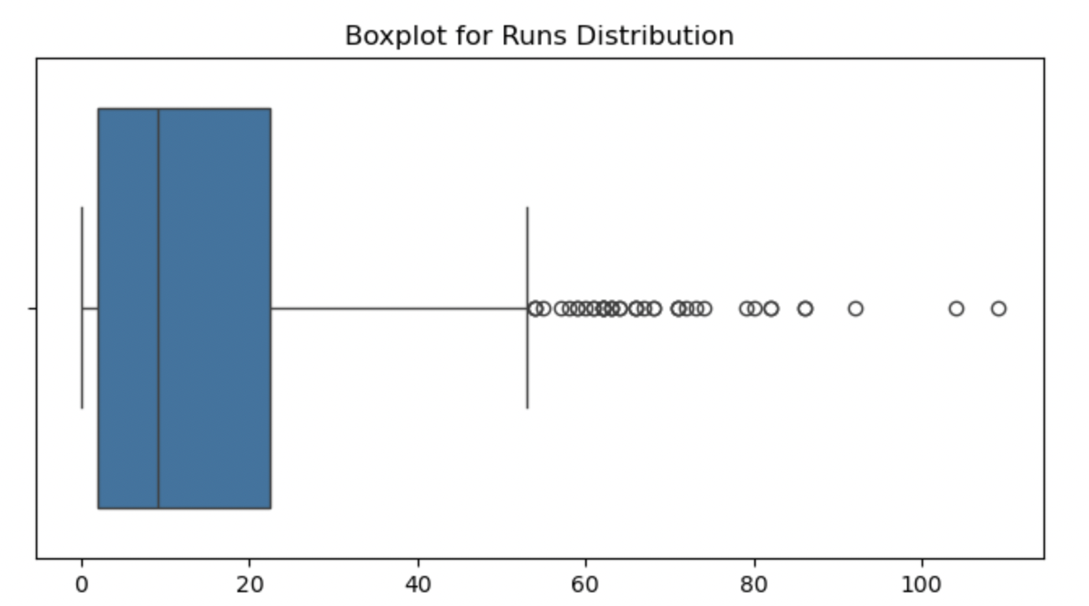
Strong Positive Correlation – More balls faced generally lead to higher runs.4s and 6s Correlation – Boundaries slightly impact total runs, indicating risk-taking. Strike Rate (SR) – Higher SR means quicker scoring; influenced more by boundaries than balls faced.
Low Economy Clusters – Most bowlers have a low economy rate, but a few have very high rates.
Histograms (Diagonal Plots) – Show individual metric distribution; most innings have low scores, with a few high-scoring outliers. Runs vs Balls – More balls faced generally lead to higher runs. Runs vs 4s & 6s – More boundaries slightly increase total runs. Strike Rate vs Balls – Strike rate depends more on scoring patterns than just balls faced. Clustering – Most players score low; few outliers have high scores, indicating risk-taking.
Outliers Detected – A few innings had very high scores, skewing the data right. Skewed Distribution – Most scores are low, with fewer high-scoring performances.

Slide 16
FUTURE WORK

Slide 17
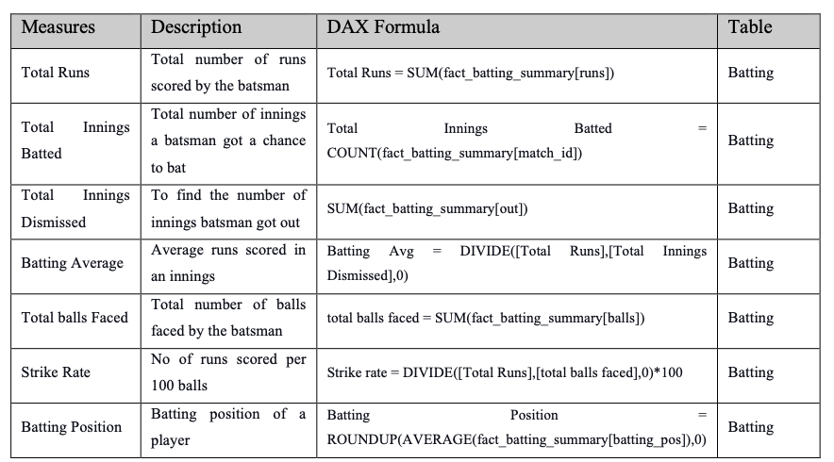
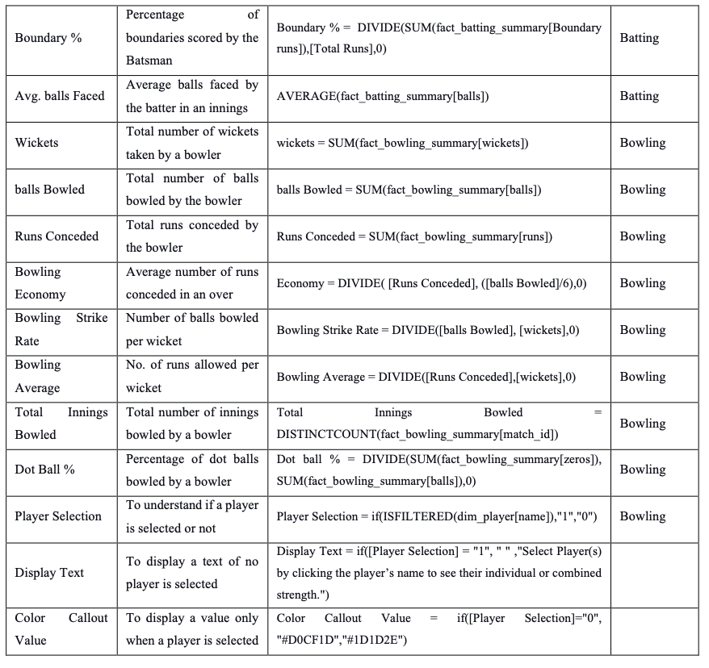
FUTURE WORK:
Using power BI DAX queries and Formulas to develop a dashboard that would give and predict teams on the given demands and requirement of certain match and grounds and against certain team.

Slide 18


THANK YOU
utmofficial
univteknologimalaysia
utm.my

